Slide 1
Easier building with Spike prime And ROBOT INVENTOR
BY SANJAY AND ARVIND SESHAN

Slide 2
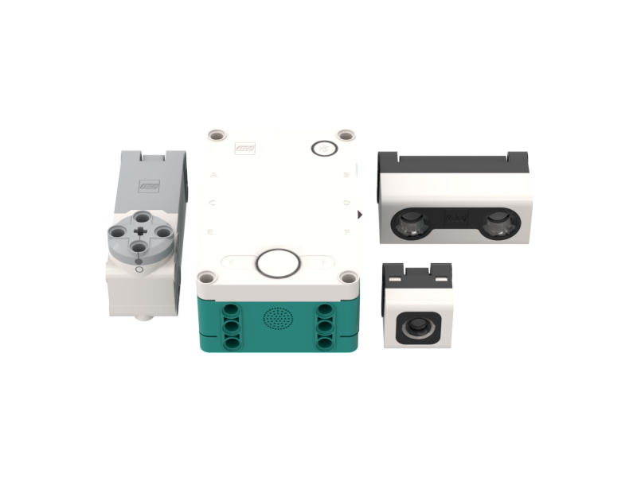
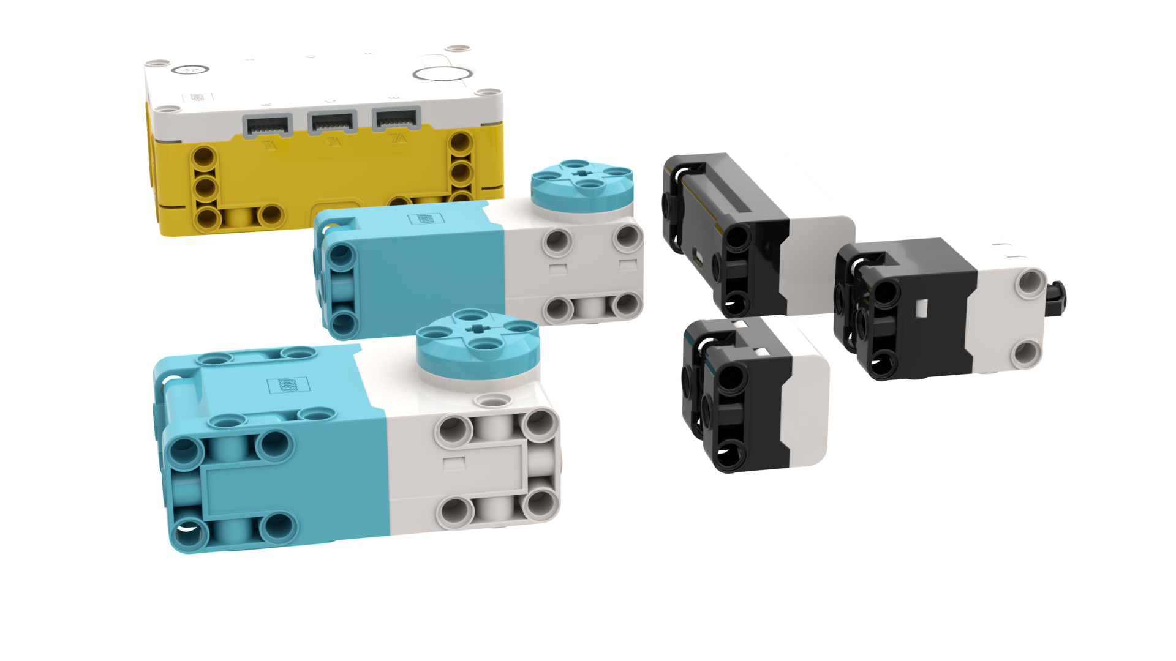
Square Form factors
The Hub, motors and sensors are all squares with Technic pin holes on all sides. This makes them easy to build with whether you are using SPIKE Prime or Robot Inventor.

Slide 3
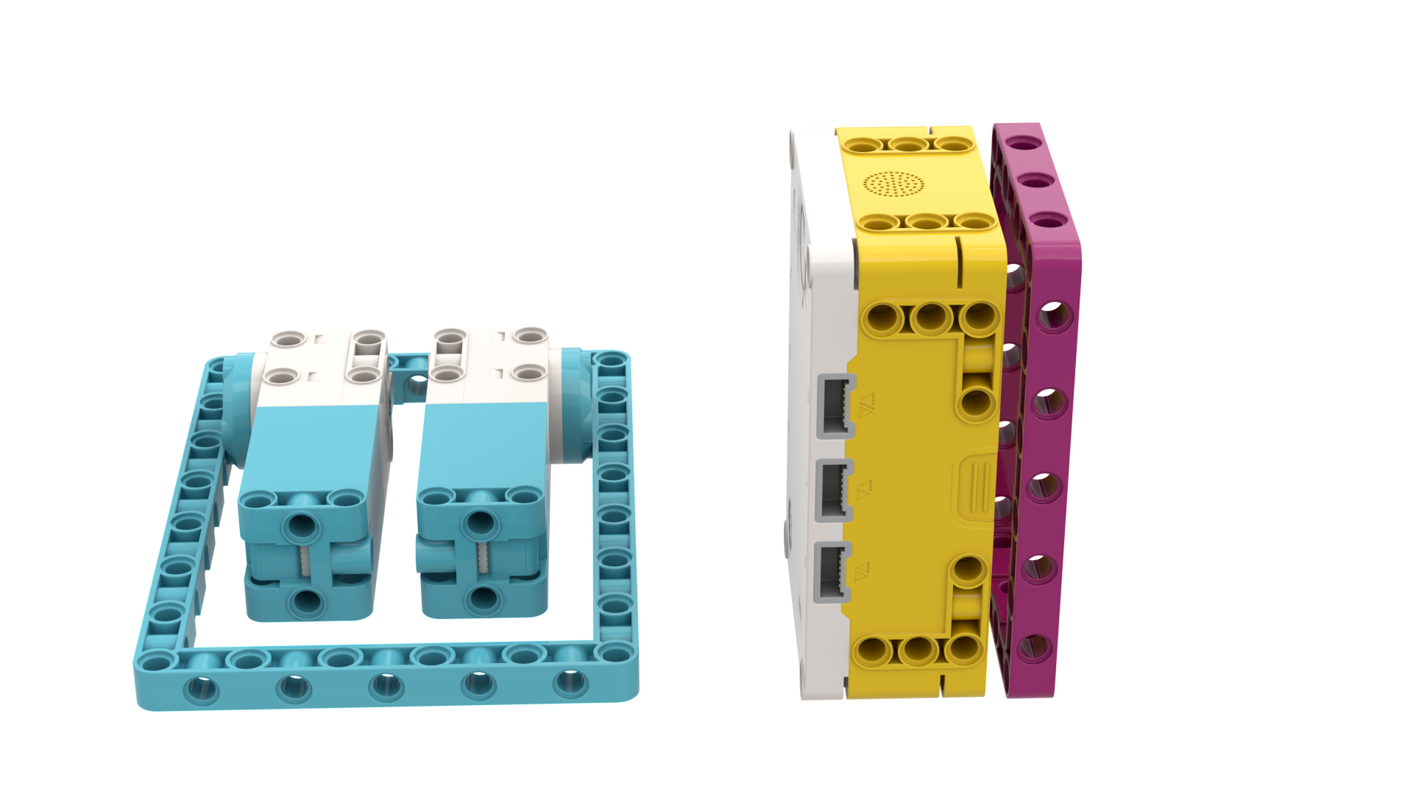
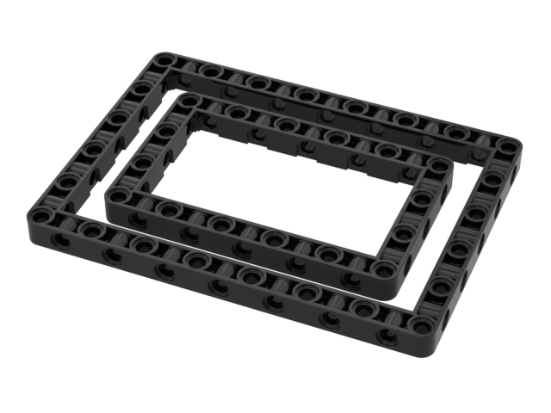
TECHNIC FRAMES (39794 and 39790)
Large Technic frames allows for faster and stronger building
New Sizes: 11 X 7 and 15 X 11
They are available in magenta and azure in SPIKE Prime, and black in Robot Inventor

Slide 4
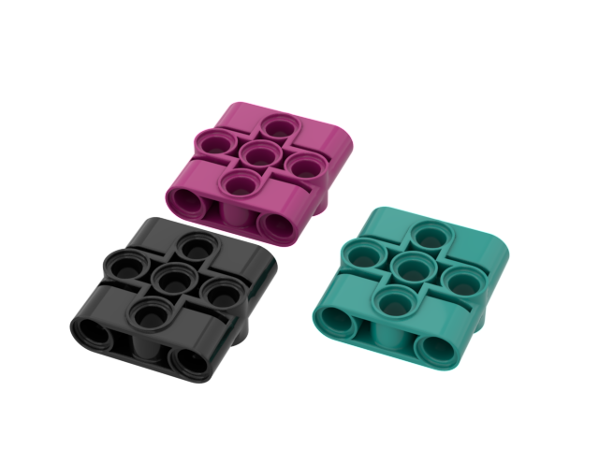
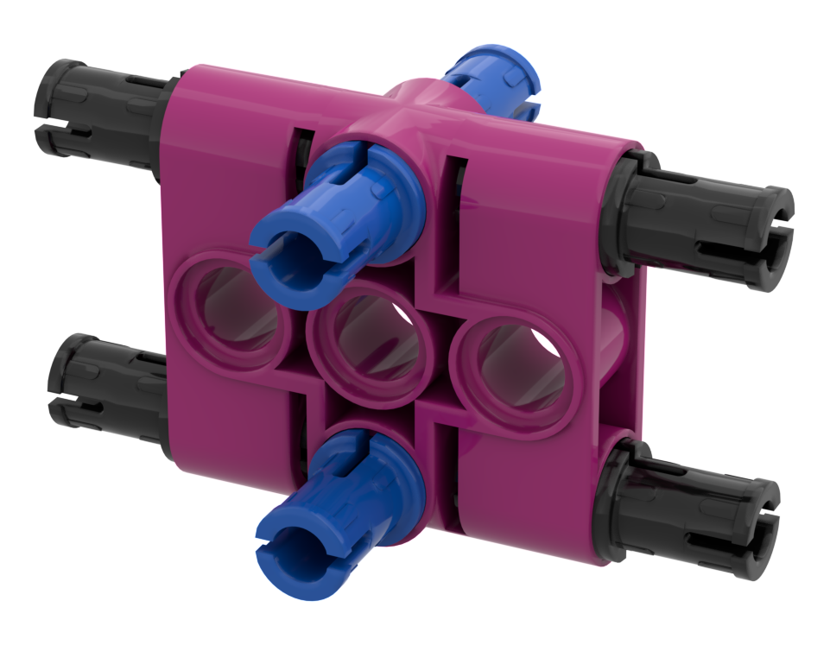
Biscuit (39793)
This 3X3 Technic element makes switching directions while building easy. They are available in both SPIKE Prime and Robot Inventor, but in different colors.

Slide 5
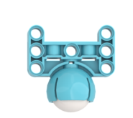
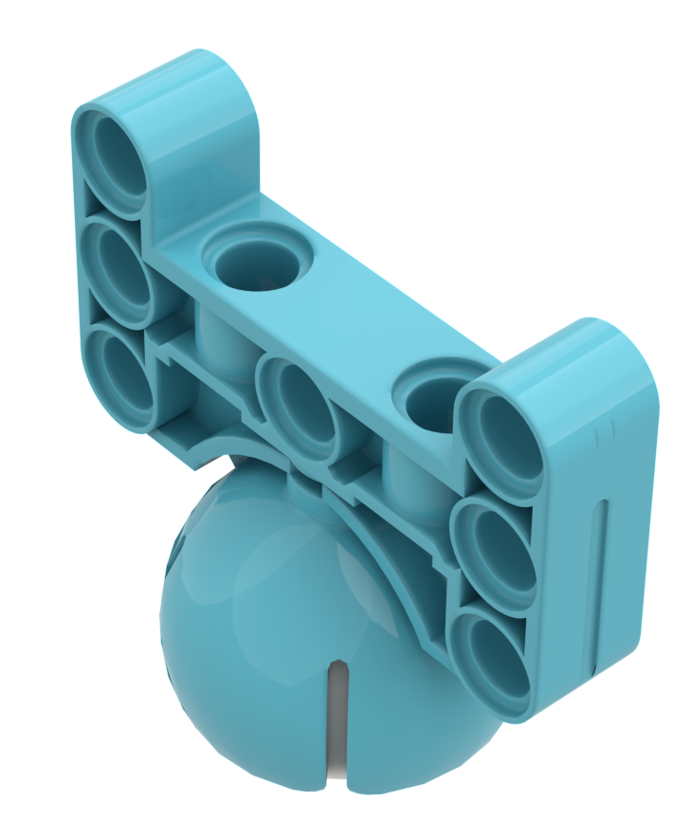
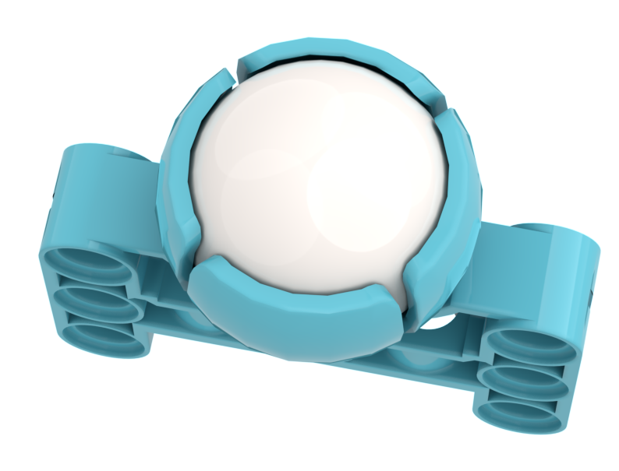
BALL and CASTOR (39370 and 52629)
This light-weight ball and castor is only in SPIKE Prime
Ball will not rust
Unlike the EV3 ball and castor, there is no hole on the top to push out the ball.
To remove the ball, slide a thin string or piece of floss in one of the slots and make you way around the ball to the opposite slot. Pull on both ends of the string and ball should pop out.

Slide 6
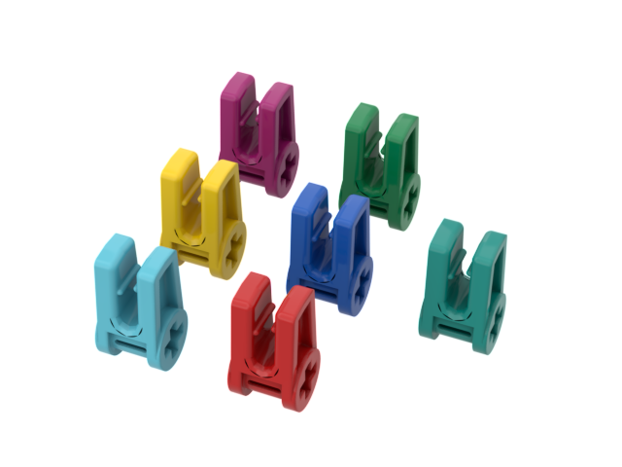
WIRE CLIPS (49283)
These wire clips make wire management on your robot easier
Only one cable will fit in each clip
You get 12 clips in the SPIKE Prime set (2 in each color).
In Robot Inventor, you get 8 all in one color (teal).
You can use them to identify different parts of your robot. (e.g. Large motors can be green, Medium motors can be red, etc.)

Slide 7
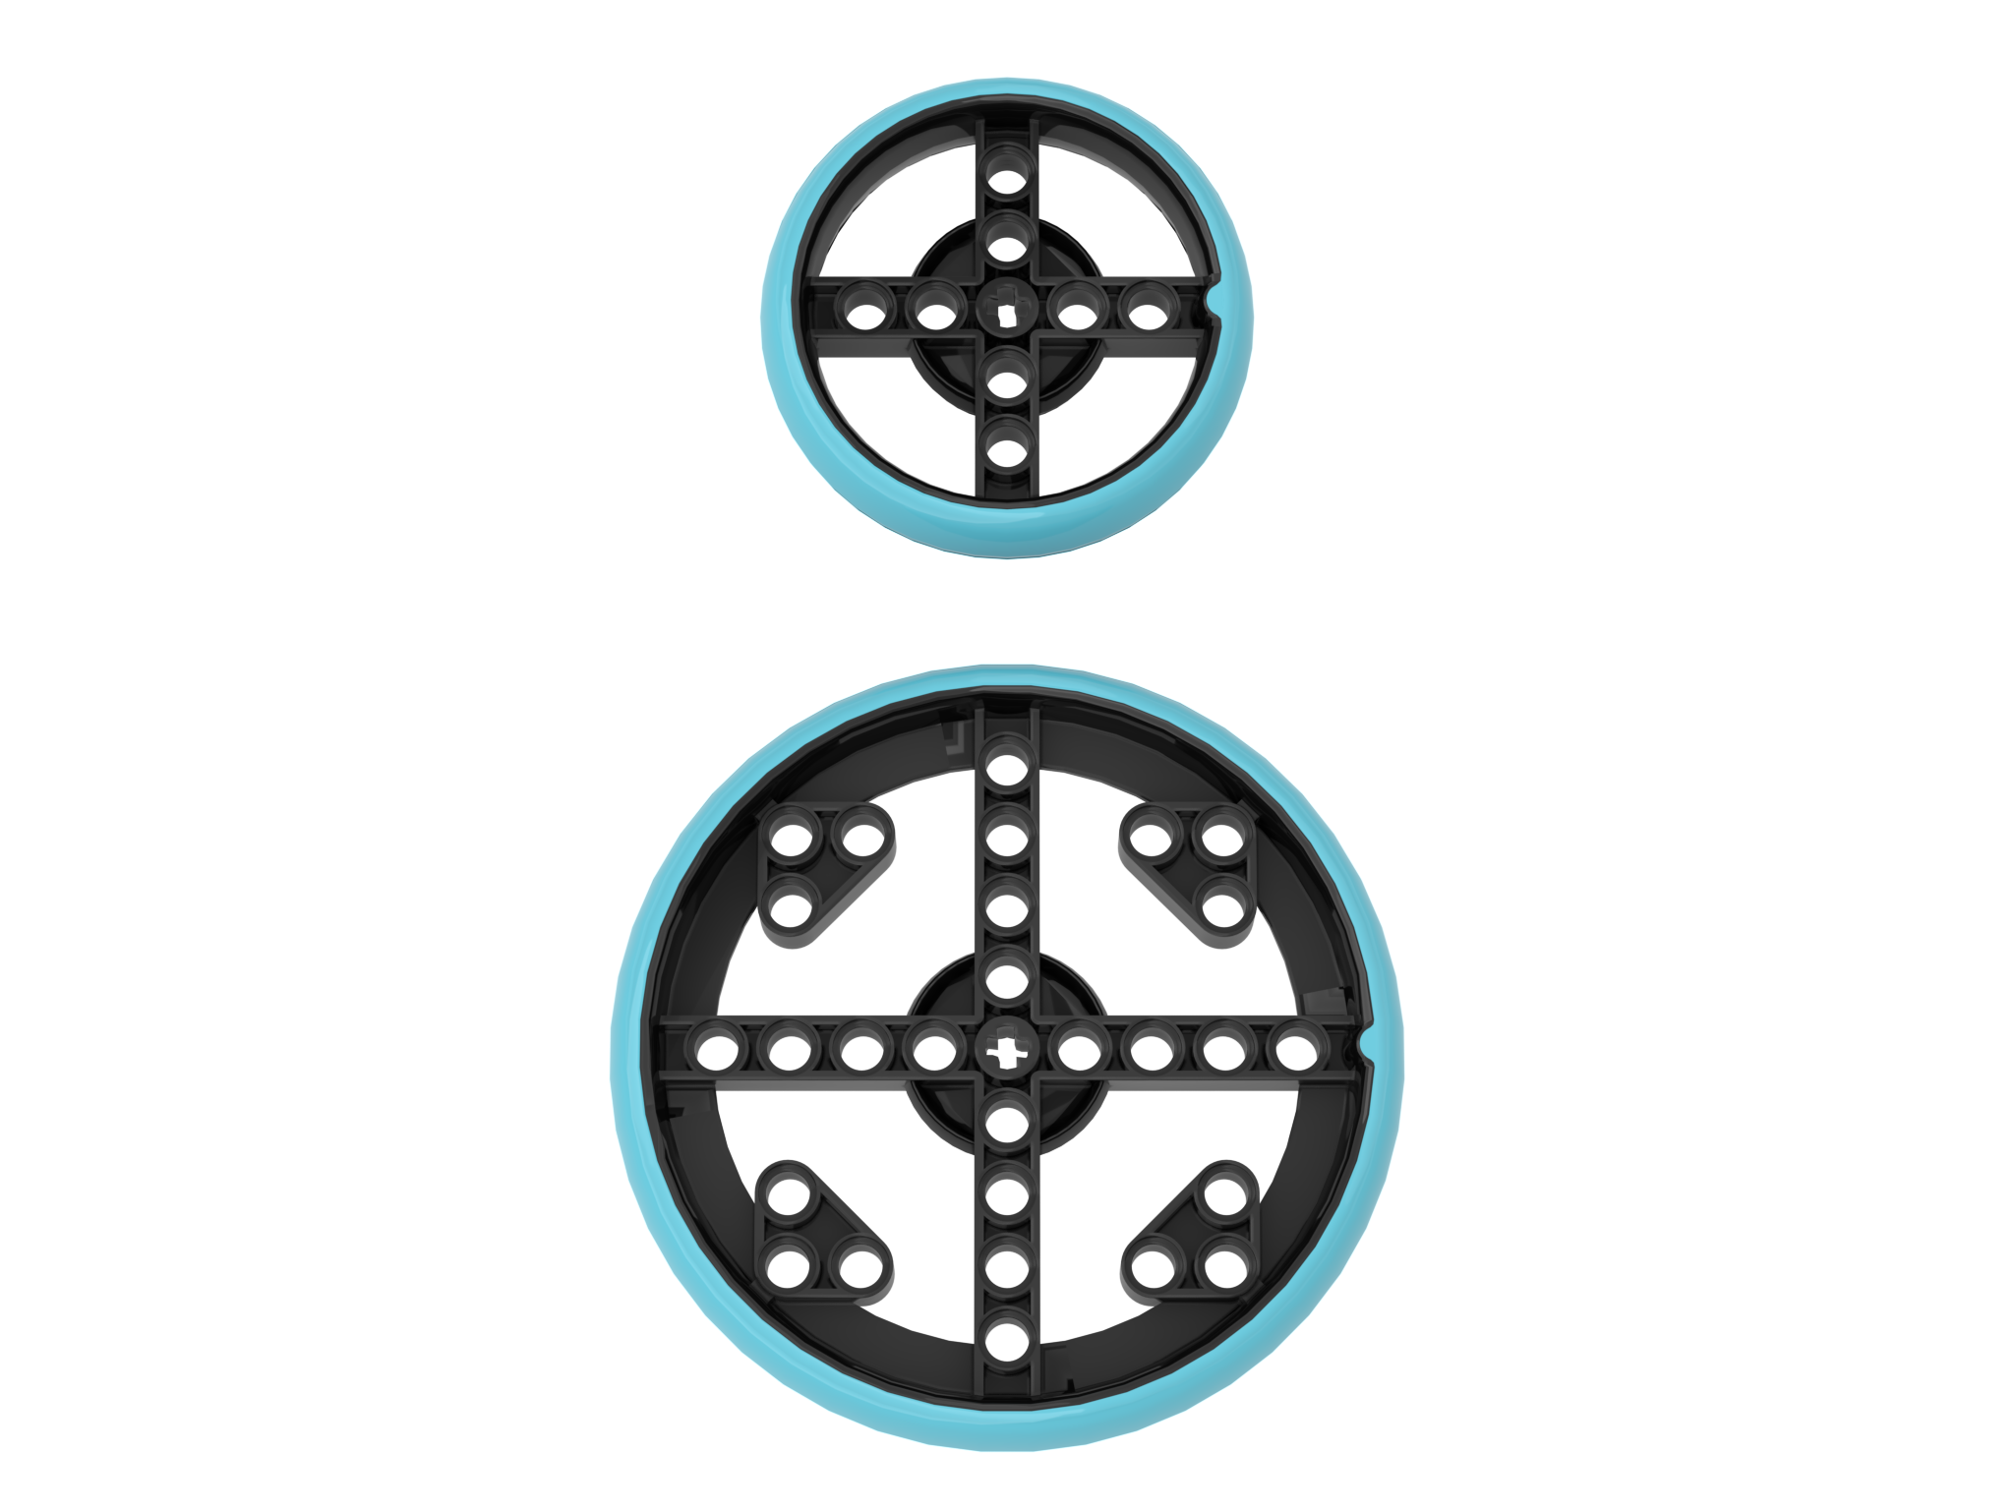
WHEELS (39367 and 49295)
The rubber tire is molded on to the rim. Therefore, they will not slip off the rim as many LEGO tires do.
The small tire is 56 X14 (same size as the wheel in the EV3 Core set)
The large tire is 88 X 14
In the Robot Inventor set, you get six 56X14 tires in all black
In SPIKE Prime, you get four 56 X14 tires in the Core Set and an additional four 88 X 14 in the Expansion Set

Slide 8
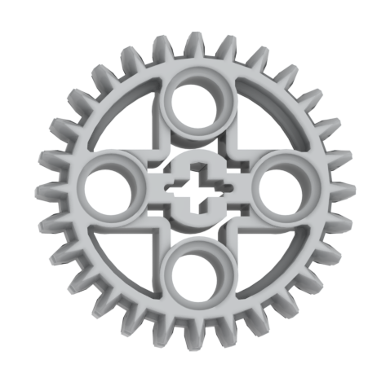
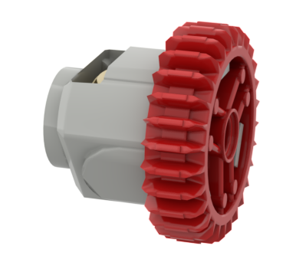
BEVEL GEAR (46372) and DIFFERENTIAL Gear (65414)
This new 28-tooth gear in SPIKE Prime gives more options for gearing
A new differential gear is available in Robot Inventor

Slide 9
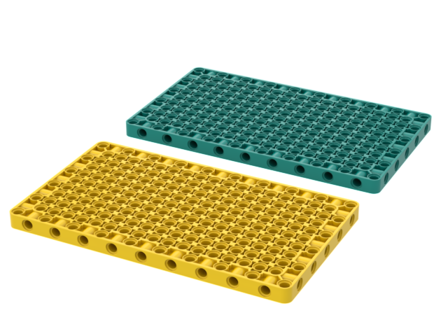

Other new elements in BOTH SETS
Technic Base Plate 11X19X1 (39369): Base plate can be used for creating stable models.
In SPIKE Prime, it is available in yellow and in Robot Inventor, it is available in teal
SPIKE Prime also comes with an integrator brick with cross axle (39789): Allows the builder to combine Technic with Systems brick

Slide 10
WHERE CAN I BUY these ELEMENTS?
LEGO Parts Replacement: https://www.lego.com/en-us/service/replacementparts
SPIKE Prime Set – 45678
Inventory: https://le-www-live-s.legocdn.com/sc/media/files/support/spike-prime/le_spike_prime_set_element_overview_classroom_poster_18x24inch-a7ecd36fbf6d15fd4c7617f4cb882531.pdf
SPIKE Prime Expansion – 45680
Inventory: https://le-www-live-s.legocdn.com/sc/media/files/support/spike-prime/le_spike_prime_expansion_set_element_overview_classroom_poster_18x24inch-1ffffebb088c5875820d767462b0a1d3.pdf
MINDSTORMS Robot Inventor – 51515
Inventory: https://brickset.com/inventories/51515-1

Slide 11

CREDITS
This lesson was created by Sanjay Seshan and Arvind Seshan for Prime Lessons
More lessons are available at www.primelessons.org
This work is licensed under a Creative Commons Attribution-NonCommercial-ShareAlike 4.0 International License.

